Slide 1
Randomized Linear Algebra can Accelerate Graph Partitioning
Erik G. Boman
Heliezer Espinoza
Jennifer Loe
SIAM CS&E 23, Amsterdam, NL
Feb. 27 – Mar. 3, 2023

Slide 2
Overview
Graph Partitioning
Spectral Partitioning
Sphynx: A Parallel Spectral Partitioner
A Randomized Eigensolver
Results
Thanks to Seher Acer for initial version of Sphynx

Slide 3
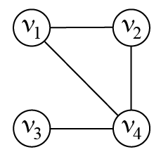
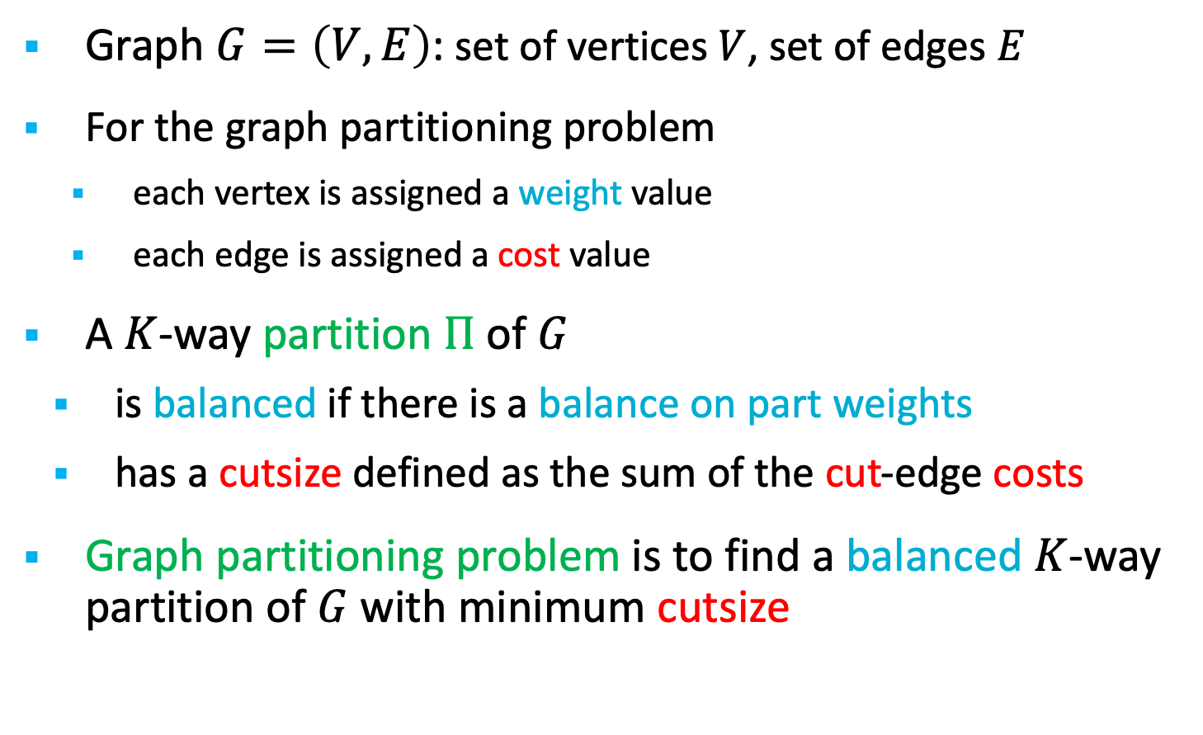
Graph Partitioning Background
Graph $G=\left(V,E\right)$: set of vertices $V$, set of edges $E$
For the graph partitioning problem
    each vertex is assigned a weight value
    each edge is assigned a cost value
A $K$-way partition $Π$ of $G$
  is balanced if there is a balance on part weights
  has a cutsize defined as the sum of the cut-edge costs
Graph partitioning problem is to find a balanced $K$-way partition of $G$ with minimum cutsize
6
1
3
2
1
Cutsize=3
3
5
1

Slide 4
Motivation - Sphynx
We are revisiting graph partitioning problem, because:
  Applications are moving to accelerators
  DoE facilities have announced different accelerators
    AMD, Intel, NVIDIA GPUs
  No accelerator-enabled graph partitioning tool exists
  We provide Sphynx to fill this gap
    Distributed-memory parallel, accelerator-enabled, and portable
Sphynx is based on a spectral approach, because:
  Spectral methods use linear-algebra kernels, which are more amenable to parallelization on accelerators
  Can potentially speed up algorithm with randomized linear algebra

Slide 5
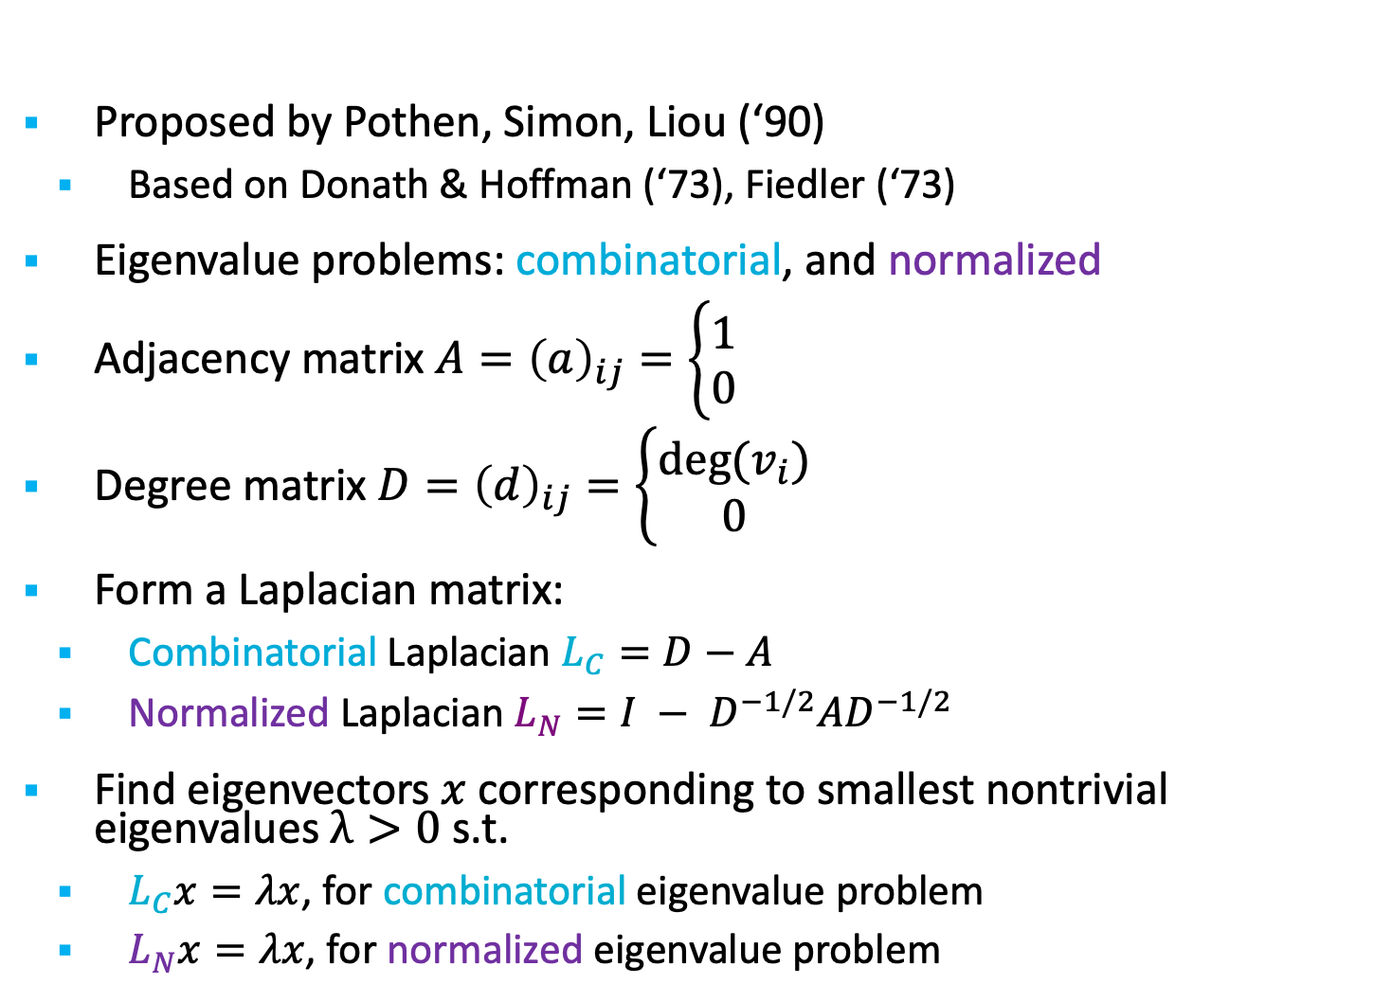
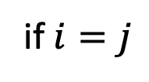

Background: Spectral partitioning
Proposed by Pothen, Simon, Liou (‘90)
  Based on Donath & Hoffman (‘73), Fiedler (‘73)
Eigenvalue problems: combinatorial, and normalized
Adjacency matrix $A={\left(a\right)}_{ij}=\left\{\begin{aligned}1 \\ 0\end{aligned}\right.$
Degree matrix $D={\left(d\right)}_{ij}=\left\{\begin{aligned}deg⁡(v_{i}) \\ 0\end{aligned}\right.$
Form a Laplacian matrix:
  Combinatorial Laplacian $L_{C}=D−A$
  Normalized Laplacian $L_{N}=I − D^{−1/2}AD^{−1/2}$
Find eigenvectors $x$ corresponding to smallest nontrivial eigenvalues $λ>0$ s.t.
  $L_{C}x=λx$, for combinatorial eigenvalue problem
  $L_{N}x=λx$, for normalized eigenvalue problem
if $e_{i,j}∈E$
otherwise
if $i=j$
otherwise

Slide 6
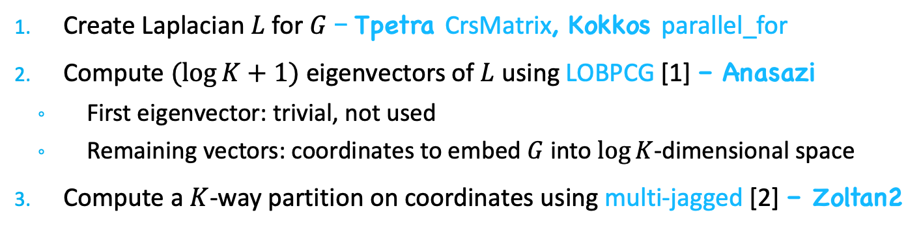
Sphynx: Parallel partitioner in Trilinos
Create Laplacian $L$ for $G$ – Tpetra CrsMatrix, Kokkos parallel_for
Compute $(log{K}+1)$ eigenvectors of $L$ using LOBPCG [1] – Anasazi
  First eigenvector: trivial, not used
  Remaining vectors: coordinates to embed $G$ into $\log{K}$-dimensional space
Compute a $K$-way partition on coordinates using multi-jagged [2] – Zoltan2
1 & 2
3
[1]
A. V. Knyazev,“Toward the optimal preconditioned eigensolver: Locally optimal block preconditioned conjugate gradient method,” SIAM Journal on Scientific Computing, vol. 23, no. 2, pp. 517–541, 2001.
[2]
M. Deveci, S. Rajamanickam, K. D. Devine, and U. V. Catalyurek, “Multi-jagged: A scalable parallel spatial partitioning algorithm,” IEEE Transactions on Parallel and Distributed Systems, vol. 27, pp. 803–817, March 2016.

Slide 7
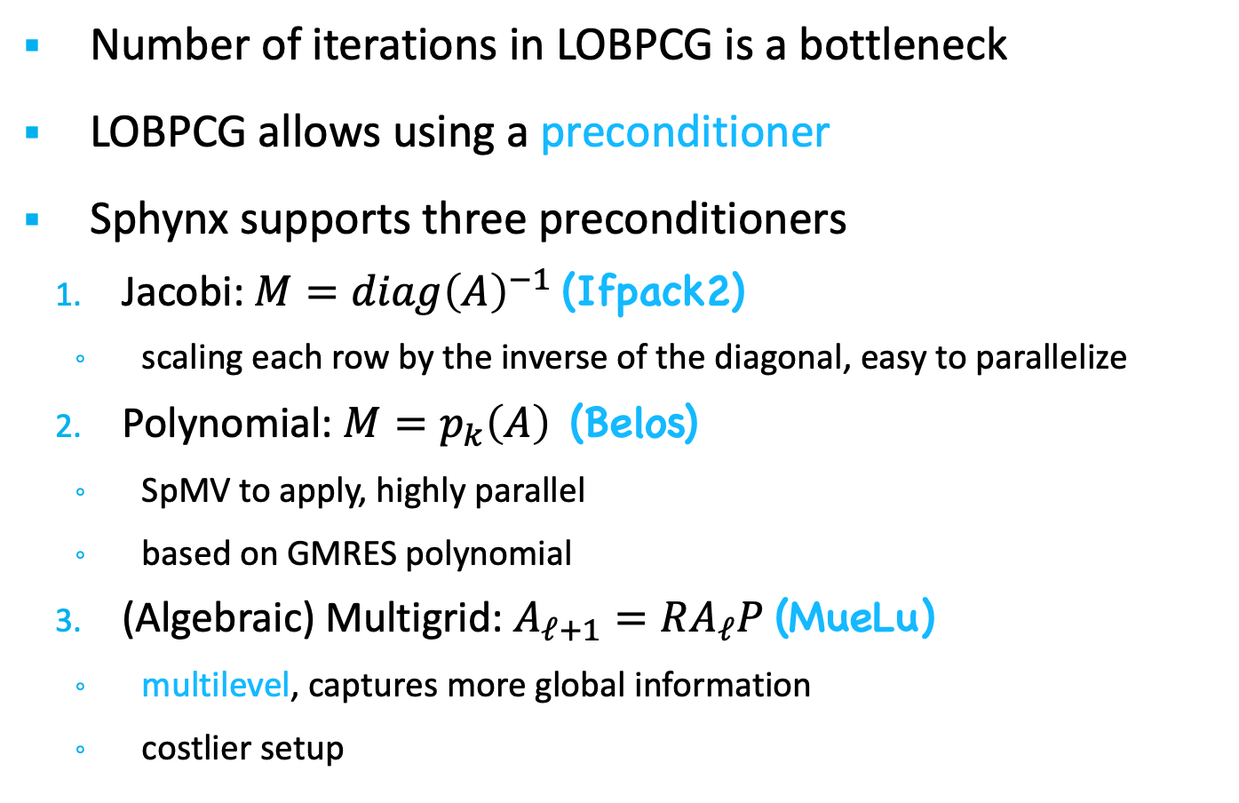
Sphynx – Preconditioning
Number of iterations in LOBPCG is a bottleneck
LOBPCG allows using a preconditioner
Sphynx supports three preconditioners
  Jacobi: $M=diag{\left(A\right)}^{−1}$ (Ifpack2)
    scaling each row by the inverse of the diagonal, easy to parallelize
  Polynomial: $M=p_{k}\left(A\right)$ (Belos)
    SpMV to apply, highly parallel
    based on GMRES polynomial
  (Algebraic) Multigrid: $A_{ℓ+1}=RA_{ℓ}P$ (MueLu)
    multilevel, captures more global information
    costlier setup

Slide 8
Sphynx – Experiments
The GPU focus: MPI+Kokkos (Cuda/HIP)
Performed on Summit and used 24 GPUs
  Desired number of parts = K = 24
Each GPU is exclusively used by one MPI rank (default)
Device allocations in the Unified Virtual Memory (default)
Initial distribution of the test graphs: 1D block
  This is the default distribution with Tpetra CrsMatrix
Parameter sensitivity and comparison against the state of the art
  Performance metrics: cutsize and runtime

Slide 9
Sphynx – Dataset
graph | #vertices | #edges | degree
 |  |  | max | avg
ecology1 | 1,000,000 | 4,996,000 | 5 | 5
dielFilterV2real | 1,157,456 | 48,538,952 | 110 | 42
thermal2 | 1,227,087 | 8,579,355 | 11 | 7
Bump_2911 | 2,852,430 | 127,670,910 | 195 | 45
Queen_4147 | 4,147,110 | 329,499,284 | 81 | 79
100^3 | 1,000,000 | 26,463,592 | 27 | 26
200^3 | 8,000,000 | 213,847,192 | 27 | 27
400^3 | 64,000,000 | 1,719,374,392 | 27 | 27
hollywood-2009 | 1,069,126 | 113,682,432 | 11,468 | 106
com-Orkut | 3,072,441 | 237,442,607 | 33,314 | 77
wikipedia-20070206 | 3,512,462 | 88,261,228 | 187,672 | 25
cit-Patents | 3,764,117 | 36,787,597 | 794 | 10
com-LiveJournal | 3,997,962 | 73,360,340 | 14,816 | 18
wb-edu | 8,863,287 | 97,233,789 | 25,782 | 11
uk-2005 | 39,252,879 | 1,602,132,663 | 1,776,859 | 41
it-2004 | 41,290,577 | 2,096,240,367 | 1,326,745 | 51
twitter7 | 41,652,230 | 2,446,678,322 | 2,997,488 | 59
com-Friendster | 65,608,366 | 3,677,742,636 | 5,215 | 56
FullChip | 2,986,914 | 26,621,906 | 2,312,481 | 9
circuit5M | 5,555,791 | 59,519,031 | 1,290,501 | 11
regular
irregular
The SuiteSparse Matrix Collection, https://sparse.tamu.edu/

Slide 10
Sphynx – Results
Comparison against ParMETIS [1] and XtraPuLP [2]
  ParMETIS and XtraPuLP do not run on GPUs
Application-friendly comparison on 24 MPI ranks
  Sphynx uses 6 MPI ranks per node and 1 GPU per rank
  ParMETIS uses 6 MPI ranks per node
  XtraPuLP uses 6 MPI ranks per node and 7 OpenMP threads per rank
Average results normalized w.r.t Sphynx
 | ParMETIS |  | XtraPuLP
 | runtime | cutsize | runtime | cutsize
regular | 0.33 | 0.81 | 0.31 | 6.36
irregular | 23.95 | 0.30 | 1.24 | 0.45
ParMETIS execution did not finish in 2 hours on 4 graphs
  Largest irregular graphs: uk-2005, it-2004, twitter7, com-Friendster
[1]
G. Karypis, V. Kumar, Parmetis: Parallel graph partitioning and sparse matrix ordering library, Tech. rep., Dept. Computer Science, University of Minnesota, 1997.
G. M. Slota, S. Rajamanickam, K. Devine, K. Madduri, Partitioning trillion-edge graphs in minutes, IPDPS, 2017.
[2]

Slide 11
Randomized Eigensolvers
The most expensive phase (90-95%) in spectral partitioning is the eigensolver
Fairly low accuracy is sufficient to obtain good partitioning
Key idea: We can use a randomized eigensolver instead of LOBPCG
  Randomized methods often get low-accuracy solutions very fast
  We follow the approach in Halko, Martinsson, Tropp (20XX)
We have explored this approach in a prototype
  HPC implementation in Trilinos/Sphynx still to do

Slide 12
Randomized Method: Phase 1
Here we will use the normalized Laplacian, L_{N}
  We estimate the largest eigenvalues of the normalized adjacency matrix, which correspond to the smallest eigenvalues of L_{N}
First, we approximate the range of A_{N}, where A_{N} = D ^{-½} A D^{-½.}
Draw a random Gaussian (normal) matrix Ω
Form Y= A_{N} ^{q} Ω
Compute skinny QR: QR = Y

Slide 13
Randomized Method: Phase 2
Second, compute eigenvalues on the projected problem.
Compute projection B = Q^{T}AQ
Solve eigenproblem for B: B = V ƛ V^{T}
Project back: U= QV
We only need to solve a small, dense eigenproblem for B
  Fast!
  No longer need LOBPCG (or any sparse eigensolver)

Slide 14
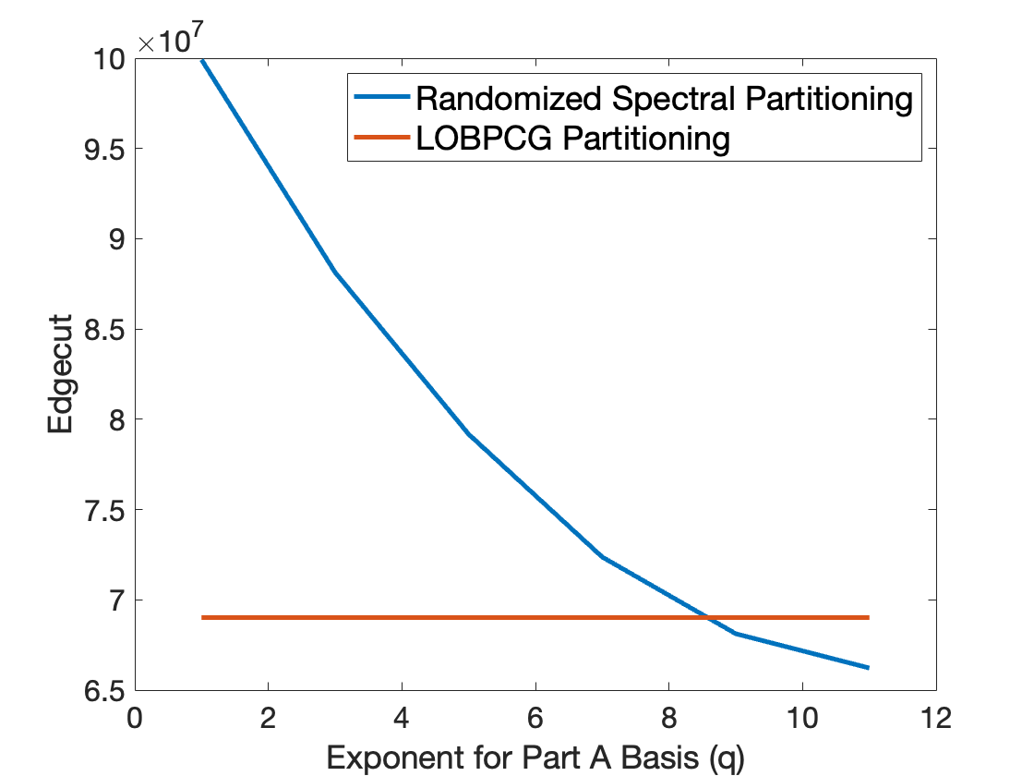
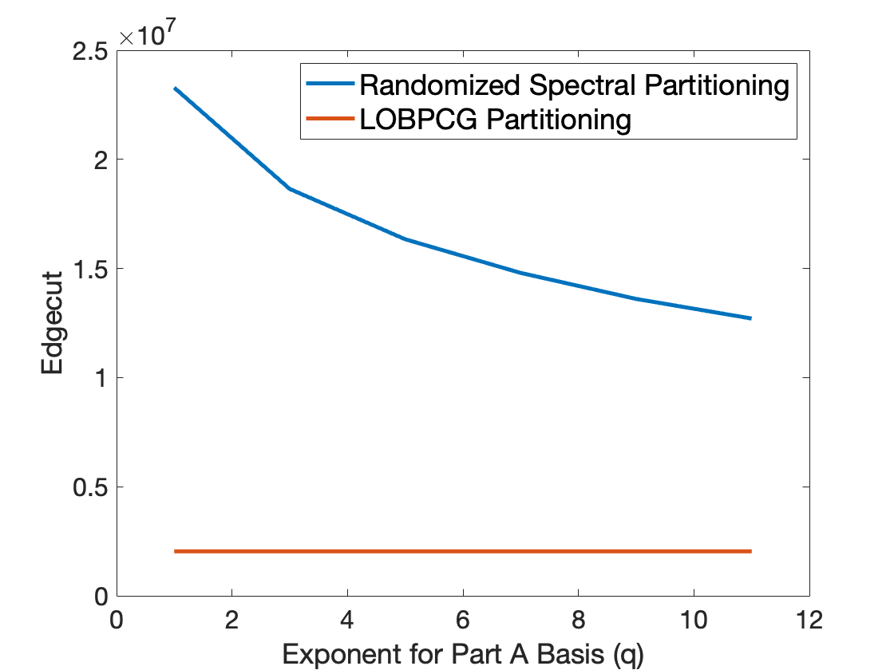
Randomized partitioning quality
Irregular: Hollywood
Regular: Brick3d
The randomized eigensolver actually works better than LOBPCG for partitioning with sufficiently large q (for irregular graphs)!

Slide 15
Results: Quality
Sphynx edge cuts with LOBPCG vs randomized solver with L=20.
Matrix | LOBPCG | q=1 | q=3 | q=5 | q=7 | q=9 | q=11
cube100 | 2,036,942 | 23,280,878 | 18,643,406 | 16,339,232 | 14,763,242 | 13,620,082 | 12,645,466
hollywood | 69,010,728 | 99,913,222 | 88,136,872 | 79,170,890 | 72,369,774 | 68,120,278 | 66,220,826
wikipedia | 70,372,336 | 82,607,424 | 80,328,958 | 77,783,740 | 74,965,720 | 71,660,478 | 69,205,042
FullChip | 19,837,100 | 21,925,964 | 18,723,240 | 17,296,392 | 16,483,600 | 15,890,706 | 15,466,674
Circuit5M | 40,918,466 | 52,793,074 | 49,117,806 | 42,290,548 | 33,731,544 | 31,757,878 | 31,563,734
Randomized method (q=11) often gives lower (better) cuts than LOBPCG !

Slide 16
Results: Run Time
Sphynx run times (CPU) with LOBPCG vs randomized solver with L=20.
Matrix | LOBPCG | q=1 | q=3 | q=5 | q=7 | q=9 | q=11
cube100 | 18.19 | 1.601 | 2.185 | 2.779 | 3.357 | 3.907 | 4.465
hollywood | 360.6 | 5.865 | 10.88 | 15.69 | 20.44 | 25.33 | 30.35
wikipedia | 923.3 | 18.59 | 33.28 | 47.75 | 62.15 | 76.45 | 90.84
FullChip | 162.8 | 5.00 | 6.24 | 7.50 | 8.79 | 10.13 | 11.38
Circuit5M | 821.5 | 11.14 | 13.98 | 16.23 | 18.27 | 21.04 | 23.93
Our randomized method is 10X-80X faster (q=1) than LOBPCG!
Also much faster with q=11 (good cuts)

Slide 17
Conclusions
  Randomized eigensolver can dramatically speed up (5-80X) a spectral partitioner
  Works well for many irregular graphs (e.g., web graphs)
    but not so well for more regular graphs (e.g., meshes)
    Perhaps related to separation of the Laplacian eigenvalues?
  Trade-off in computational cost vs quality
  Sphynx has been released in Trilinos/Zoltan2
    Randomized method in progress (will be released soon)
  All spectral methods have some weaknesses
    Often slower than multilevel methods and sometimes worse cuts
    Collaboration with K. Madduri and M. Gilbert (Penn State) may address this
  Future work:
    Add refinement: Will improve cut quality but take more time
    Alternatives to Multijagged geometric partitioning (QRCP?)
This research was supported by the Exascale Computing Project (17-SC-20-SC), a collaborative effort of the U.S. Department of Energy Office of Science and the National Nuclear Security Administration.

Slide 18
Extra slides

Slide 19
Why Revisit Spectral Methods Now?
Weren’t they abandoned in the ‘90s and replaced by multilevel methods? Yes, but…
Quality of spectral partitioners are often only slightly worse than multilevel.
Preconditioned eigensolvers (LOBPCG) came later.
Linear algebra operations have been optimized for GPU.
Spectral partitioning is robust for large #proc (#GPU), as eigenvectors don’t change

Slide 20
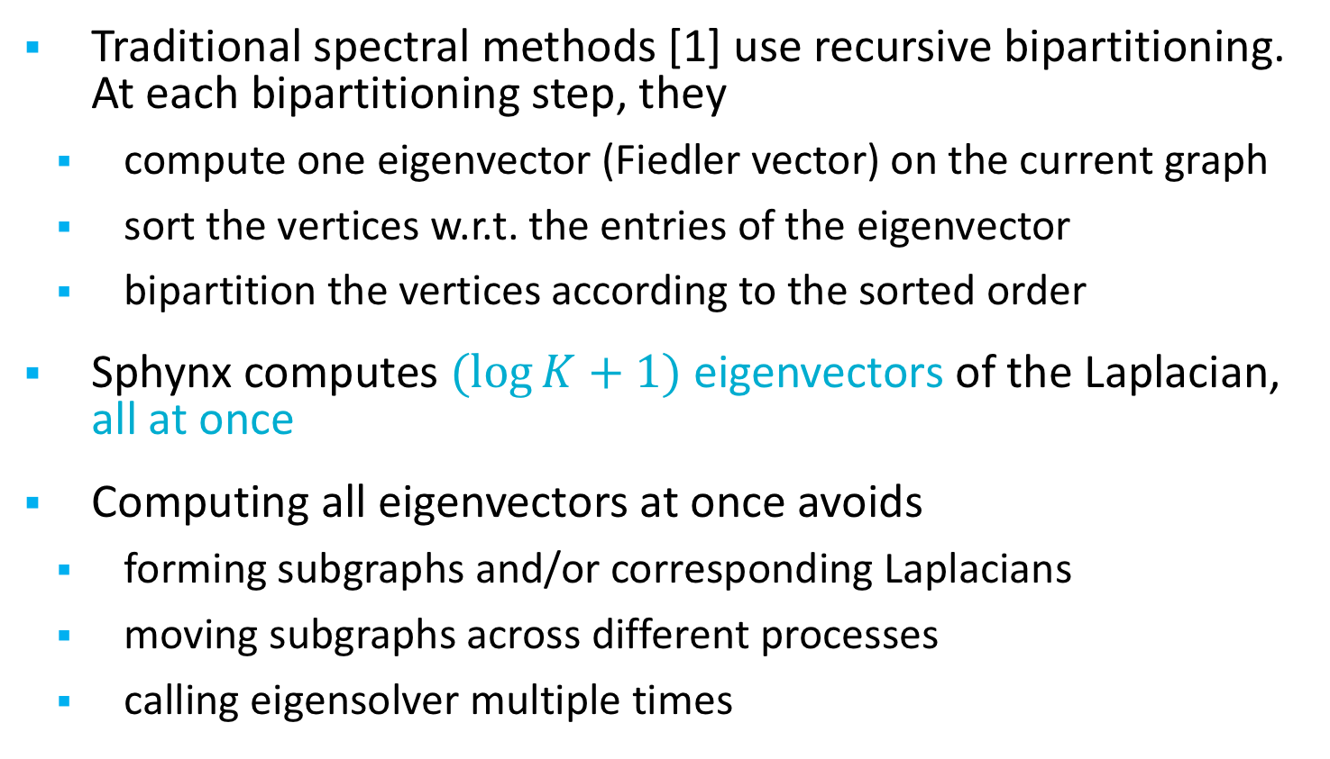
Sphynx – Spectral partitioning
Traditional spectral methods [1] use recursive bipartitioning. At each bipartitioning step, they
  compute one eigenvector (Fiedler vector) on the current graph
  sort the vertices w.r.t. the entries of the eigenvector
  bipartition the vertices according to the sorted order
Sphynx computes $(log{K+1)}$ eigenvectors of the Laplacian, all at once
Computing all eigenvectors at once avoids
  forming subgraphs and/or corresponding Laplacians
  moving subgraphs across different processes
  calling eigensolver multiple times
[1]
A. Pothen, H. Simon, and K. Liou, “Partitioning sparse matrices with eigenvectors of graphs,” SIAM J. Matrix Anal., vol. 11, pp. 430–452, July 1990.

Slide 21
Sphynx – Results
LOBPCG Convergence Tolerance:
  Default: 1e-2 for MueLu
  1e-3 for others
  Default: 1e-2 for all

Slide 22
Sphynx – Results
Eigenvalue Problem:
Average results normalized w.r.t combinatorial
 | preconditioner | generalized |  | normalized
 |  | runtime | cutsize | runtime | cutsize
regular | Jacobi | 0.81 | 1.15 | 0.43 | 2.26
 | Polynomial | 0.73 | 1.21 | 0.54 | 2.45
 | MueLu | 0.99 | 1.12 | 0.95 | 2.20
irregular | Jacobi | 0.75 | 0.83 | 0.26 | 1.36
 | Polynomial | 0.36 | 0.84 | 0.02 | 0.83
 | MueLu | 0.71 | 0.90 | 0.31 | 1.68
  Default: combinatorial for regular graphs,
  generalized for irregular graphs with Jacobi and MueLu, and
  normalized for irregular graphs with Polynomial.

Slide 23
Sphynx – Results
Preconditioner:
Average results normalized w.r.t. Jacobi
 | Polynomial |  | MueLu
 | runtime | cutsize | runtime | cutsize
regular | 0.46 | 1.03 | 0.42 | 0.91
irregular | 0.62 | 1.71 | 1.91 | 0.94
  Suggested: MueLu for regular graphs,
  Polynomial for irregular graphs.

Slide 24

Sphynx: Exascale Systems
Sphynx Running Time on OLCF systems:
Summit: Nvidia Volta V100
Spock: AMD MI200
RUNNING TIME (s)
 | Summit | Spock | Spock/Summit
ecology1 | 1.40 | 0.65 | 0.47
dielFilterV2real | 2.13 | 1.61 | 0.75
thermal2 | 1.78 | 1.22 | 0.69
Bump_2911 | 1.68 | 1.35 | 0.80
Queen_4147 | 2.20 | 1.61 | 0.73
100^3 | 1.39 | 0.97 | 0.70
200^3 | 2.11 | 1.78 | 0.84
400^3 | 6.78 | 7.75 | 1.14
geomean |  |  | 0.75
hollywood-2009 | 4.79 | 3.60 | 0.75
com-Orkut | 8.06 | 7.52 | 0.93
wikipedia-20070206 | 15.66 | 18.44 | 1.18
cit-Patents | 8.27 | 7.75 | 0.94
com-LiveJournal | 8.70 | 7.81 | 0.90
wb-edu | 5.54 | 6.55 | 1.18
uk-2005 | 89.31 | 137.59 | 1.54
it-2004 | 90.24 | 101.58 | 1.13
twitter7 | 482.85 | 499.43 | 1.03
com-Friendster | 186.16 | 135.20 | 0.73
FullChip | 48.36 | 77.56 | 1.60
circuit5M | 43.55 | 47.87 | 1.10
geomean |  |  | 1.05

